Slide 1
Fruit fly lab practical
Dr Lena Grinsted, university of Portsmouth
March 2021

Slide 2
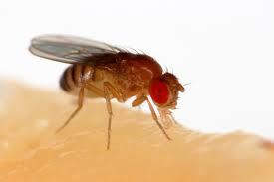
Learning objectives
To gain practical experience decoding animal behaviour from video recordings
To consider how temperature may affect physiological processes and animal behaviour
To compare and contrast data from manually versus automatically generated behavioural data
To practise hypothesis testing
Drosophila melanogaster
Remember to take notes throughout for your coursework!
Notes:
No need for students to take notes: they will get a lab protocol that includes all information

Slide 3
Experimental overview
2 x 24 well plates, each with a single fly in each well (arena)
Exposed each plate to a condition: a range of temperature changes
Condition A
Condition B
1 2 3 4 5 6
A
B
C
D
1 2 3 4 5 6
A
B
C
D
Notes:
Each circle is an arena that contains a single fruit fly

Slide 4
Temperature conditions
Condition A (abbreviation: CA): Increase-Decrease
6
7
5
8
Block 1
9
4
3
10
2
11
Notes:
11 blocks of each 20min: a 30sec video recording was taken towards the end of the 20min of each block

Slide 5
Temperature conditions
Condition B (abbreviation: CB): Decrease-Increase
2
11
3
10
Block 1
9
4
5
8
6
7

Slide 6
Hypothesis testing
Ambient temperature
Behaviour and/or physiology
HYPOTHESIS
An educated guess
Based on a strong scientific rationale
PREDICTION(S) derived from the hypothesis
Should identify your specific independent variable(s) and your dependent variable(s), and which relationship you would expect between these them
Relationships can be positive, negative, or neutral
Support?
Ambient temperature
1) Time spent moving
2) Distance moved
3) Speed of movement
(independent)
(dependent)
Notes:
Hypothesis: can be a bit broad and relate to how temperature affects both physiology and behaviour
Predictions are derived from the hypothesis and are more specific: they explain what we expect (based on our hypothesis) will happen to our specific dependent variables in response to a change in our independent variable
We actually test the predictions, not the hypothesis. Based on our results we can then say whether or not we found support for our hypothesis

Slide 7
Self-directed introduction (~10min)
Read Intro and Experiment Overview (pages 3-4)
Watch YouTube video (link: top of page 5)
Watch only the first 5min 45sec
Recommended playback speed: 1.25, 1.50 or 1.75
Notes:
Ask students to spend 10min on this and give them a pdf of or a link to the lab manual

Slide 8
Hypotheses and Predictions (Discuss 10-15min) Steps 2-3 in lab protocol
Ambient temperature
Behaviour and/or physiology
HYPOTHESIS
An educated guess
Based on a strong scientific rationale
PREDICTION(S) derived from the hypothesis
Should identify your specific dependent variable(s) and your independent variable(s), and which relationship you would expect between these them
Relationships can be positive, negative, or neutral
Support?
Ambient temperature
1) Time spent moving
2) Distance moved
3) Speed of movement
(independent)
(dependent)
Notes:
Encourage students to take a screen shot of this
Tell them to take detailed notes as they will need these later on

Slide 9
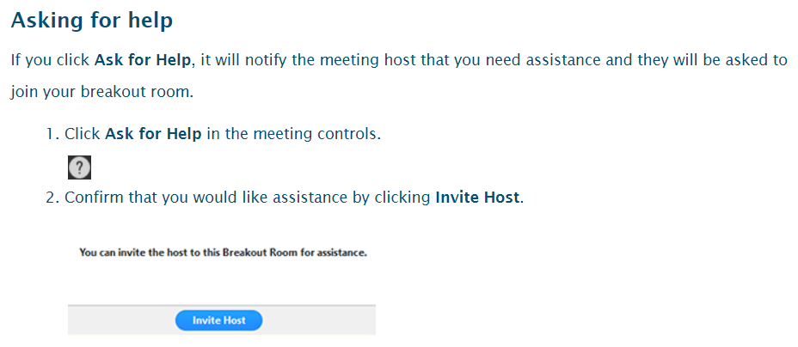
Call for help from your breakout room
Please engage and discuss as a group!
Please do turn on your microphone (and camera if you can)!
Notes:
Split them into groups / virtual breakout rooms
Each group of 5 students should be given a set ID (A, B or C) and 5 student IDs (either the numbers 1-5 or 6-10)
Stress how important it is that they engage and talk to each other and discuss this as a group
Strongly encourage them to leave their microphone and video on

Slide 10
Lab prac…

Slide 11
Circadian rhythm
Fruit fly activity patterns in different temperature ranges and various light:dark cycles (here: 16h light: 8h dark)
16 C 26 C
21 C 31 C
Fruit fly activity level
Time (hours)
Ref: Bywalez et al. (2012) Jour Biol & Med Rhythm Research
Notes:
Discuss relevant results from this paper and how many factors can influence activity levels

Slide 12
Take-home messages
Behavioural data is highly variable
Within- and among-individual variation
Increasing the sample size gives more reliable results
Increasing the sampling effort (e.g. longer video recordings) might help to reduce variation
Manual vs. automated data recording
Manual decoding of behaviour can be highly subjective
Automated data recording may also include errors, e.g. record movement when a fly is only cleaning itself
Hypothesis testing
Predicting animal behaviour is not trivial: hypothesis are often not supported
Unexpected results are common in behavioural studies
Testing the effect of a single factor may not be appropriate: In this case circadian rhythms would have affected the results
Future studies would need to take many more variables into account

