Slide 2
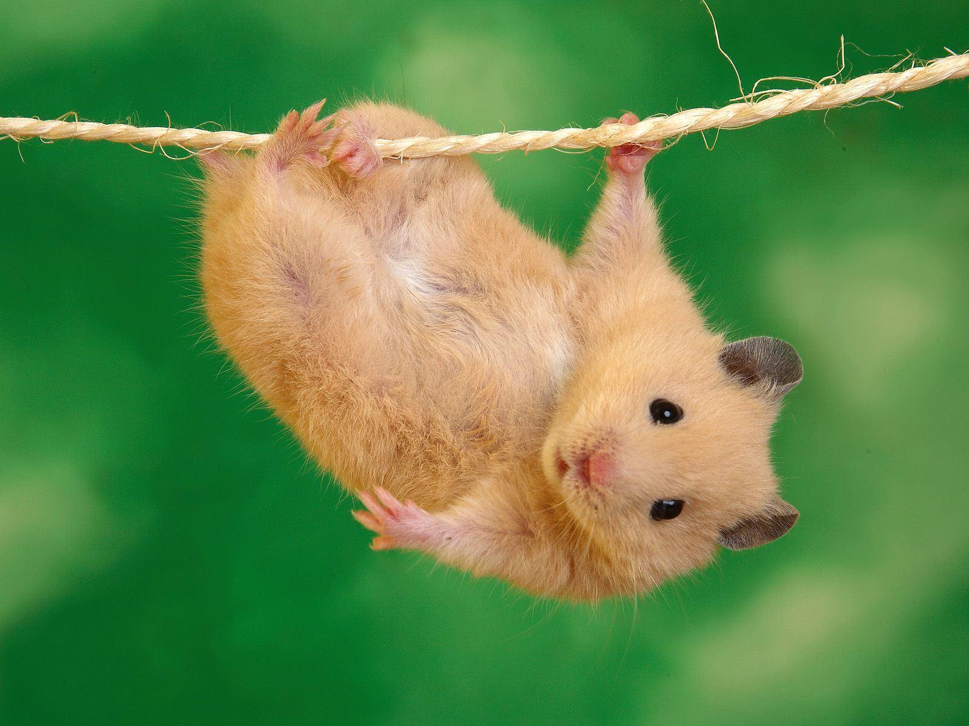
Notes:
What’s this? (a hamster)
Where does it live in the wild? (Syrian desert)

Slide 3
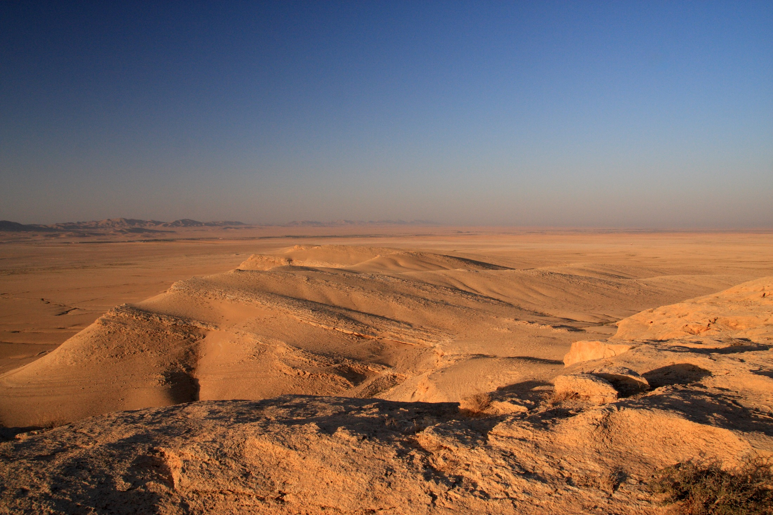
Notes:
Syrian desert
What’s life like in the desert?
What adaptations will enable a hamster live here?

Slide 4
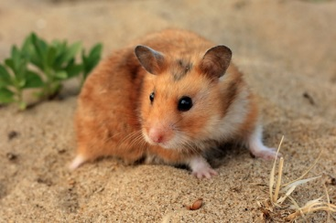

Slide 5
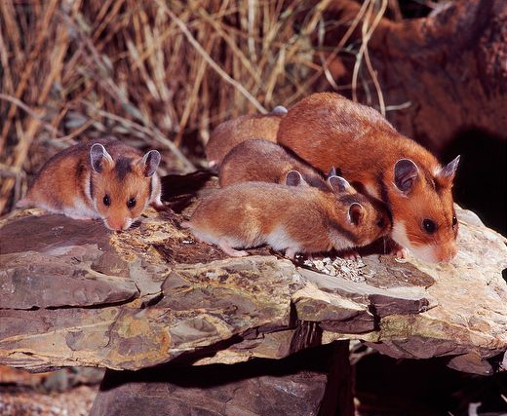

Slide 6
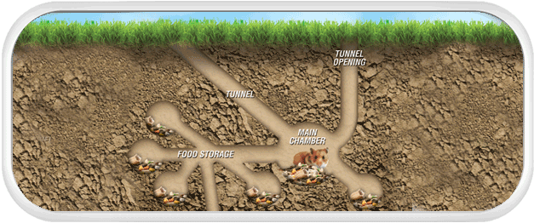

Slide 7
Sit in circle...

Slide 8
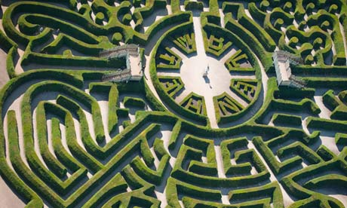

Slide 9
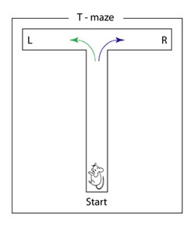
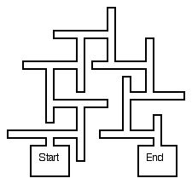

Slide 10
Questions you can answer with a maze...
How quickly can a hamster learn a maze?
Do they get quicker over time?
How do they explore the maze - do they alternate turns or is it random?
Does a left turn increase the likelihood that the next turn is a right turn?
Do they prefer different types of food?
Any other ideas?

